Slide 1
Capstone Project: Analytical CRM Development for a Bank
BY
GAURAV SINGH

Slide 2
CONTENT
Introduction
Problem statement
Data DESCRIPTION
OBJECTIVE AND SUBJECTIVE INSIGHTS
CONCLUSION

Slide 3
INTRODUCTION
Analytical CRM Development for a Bank involves the implementation of advanced analytics and intelligent decision-making tools to enhance customer experiences and drive business growth. This specialized CRM system enables banks to analyze customer data comprehensively, identify trends, and make data-driven decisions. By leveraging analytical capabilities, banks can segment customers, track behaviors, predict patterns, and monitor changes effectively. The goal is to improve customer engagement, satisfaction, and retention by tailoring marketing campaigns and personalized offers based on data insights. Analytical CRM in the banking sector plays a crucial role in understanding customer behavior, enhancing operational efficiency, and ultimately fostering long-term customer relationships.

Slide 4
PROBLEM STATEMENT
Customer Churn and its impact on business
Customer churn, the rate at which customers stop using a company's products or services, is a crucial metric for banks.
It directly impacts revenue and profitability.
In this presentation, we will analyze our bank's customer churn rates, focusing on gender, recent years, customers with credit cards, number of products used, credit score-wise churn count, and geography-wise churn count.
Our goal is to identify factors contributing to churn and propose strategies to improve customer retention and satisfaction.

Slide 5
DATA DESCRIPTION
Row Number: The row number in the dataset, likely used for reference or indexing.
Customer ID: A unique identifier for each customer.
Credit Score: A numerical representation of the customer's creditworthiness.
Credit score:
Excellent : >800
Very Good : 740–799
Good : 670–739
Fair : 581–669
Poor : <580
Geography ID: A numerical identifier that likely corresponds to a geographical location, such as a country or region.
Gender ID: A numerical identifier for the customer's gender, where for example, '1' could represent male and '2' could represent female.
Age: The age of the customer.

Slide 6
Tenure: The number of years the customer has been with the bank.
Balance: Current balance in the customer's account.
Num Of Products: refers to the number of products that a customer has purchased through the bank.
Has Cr Card: denotes whether or not a customer has a credit card. This column is also relevant, since people with a credit card are less likely to leave the bank.
1 represents credit card holder
0 represents non credit card holder
Is Active Member: active customers are less likely to leave the bank (as per the criteria defined by the bank for identifying the activeness).
1 represents Active Member
0 represents Inactive Member
Estimated Salary: as with balance, people with lower salaries are more likely to leave the bank compared to those with higher salaries.
Exited: whether or not the customer left the bank.
0 represents Retain
1 represents Exit
Bank DOJ: date when the Customer associated/joined with the bank.

Slide 7
Objective and subjective Insights
CHURN RATE TRENDS
Churn by age
CHURN BY NUM OF PRODUCTS
Credit card on customer churn
CUSTOMER JOINING AND CHURN RATE OVER YEARS
Account balance and num of products
CUSTOMER EXITED BY CREDIT SCORE SEGMENT

Slide 8
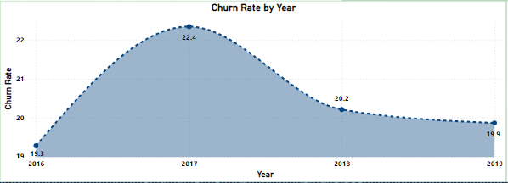
CHURN RATE TRENDS
The churn rate increases significantly between the year 2016 to 2017.
After significant increases in the churn rate, its stabilize in the year 2018 and 2019.
RECOMMENDATION : Monitor closely for emerging trends and develop target strategies for stability.

Slide 9
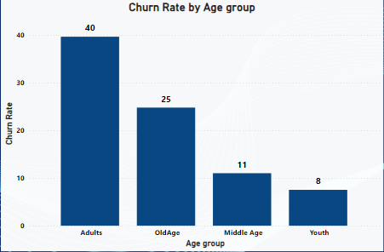
CHURN BY AGE
Age Group – Adults (40 Churn Rate)
High churn rate suggests potential dissatisfaction or unmet needs.
Reasons could include lack of personalized services or better offers from competitors.
Recommend further investigation into specific pain points or service gaps.
Age Group Middle Aged (26 Churn Rate)
Significant churn rate indicating possible issues.
Factors may include retirement planning or changing financial priorities.
Tailor retention strategies based on understanding their financial needs and concerns.

Slide 10
SUGGESTION
Develop campaigns focused on their financial goals.
Highlight services like retirement planning and investment options.
Enhance support for older customers.
Train reps to address their unique concerns.
Implement programs rewarding long-term customers.
Create bundled offerings to encourage multiple product usage.
Offer tailored product bundles and exclusive discounts.

Slide 11
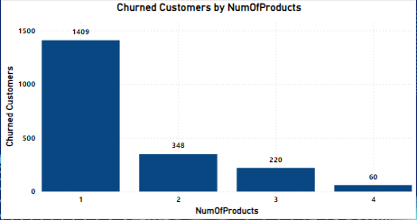
CHURNED CUSTOMER BY NUM OF PRODUCTS
ANALYSIS :
Customers using 1 product have highest churn count (1409).
Churn count decreases as the number of products used increases. Suggest product bundling to incentivize multiple product usage
SUGGESTION :
Offer bundled products or incentives for multiple product adoption.
Use data analytics for personalized product recommendations.
Enhance value proposition for using multiple products.
Launch targeted retention campaigns for single-product customers.

Slide 12
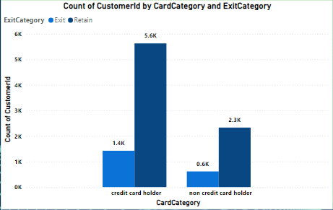
CREDIT CARD ON CUSTOMER CHURN
The Bar chart shows customers by credit card status and churned/exited status.
5.5K of credit card holders have exited or churned.
2K of non-credit card holders have churned.
Credit card ownership significantly impacts customer retention rates.
Strategies to Reduce Churn:
Improve Customer Engagement
Competitive Product Offerings
Financial Education
Feedback Mechanism
Continuous Improvement

Slide 13
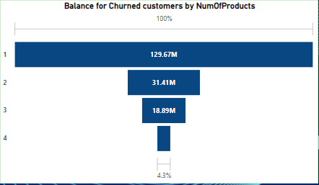
BALANCE AND NUM OF PRODUCTS
ANALYSIS :
Customers with higher product usage tend to have higher total account balances.
Customers using 1 product contribute significantly to the total account balance.
SUGGESTION :
Encourage customers to use multiple products to increase overall account balances.
Offer incentives or rewards for customers who adopt additional banking products.

Slide 14
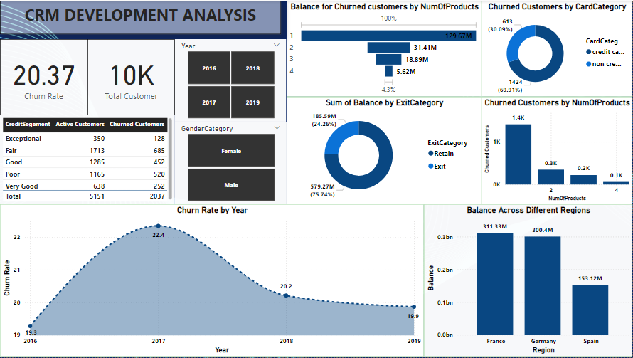
DASHBOARD

Slide 15
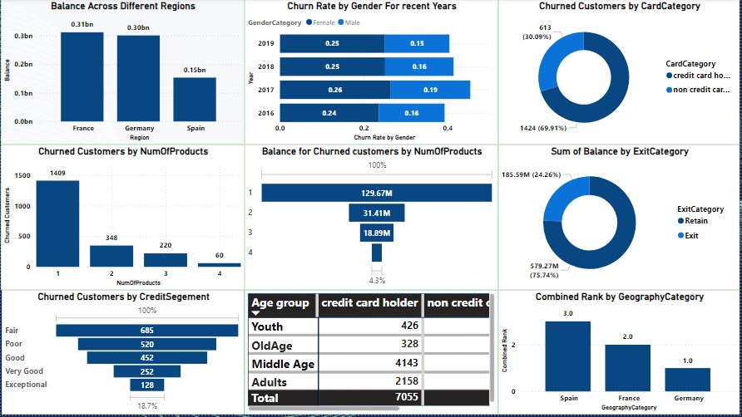
OBJECTIVE INSIGHTS

Slide 16
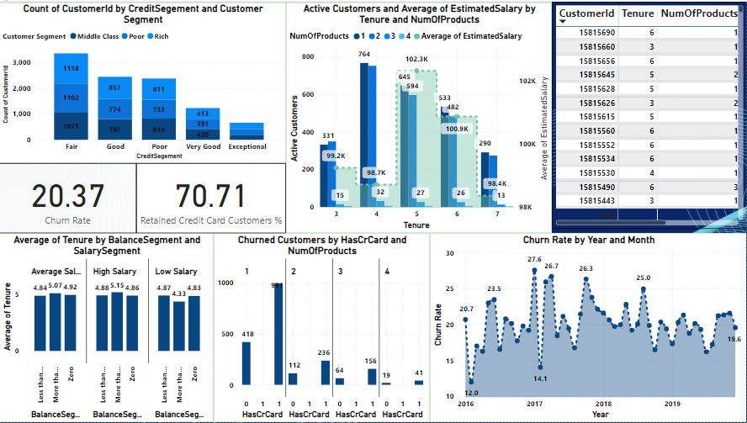
SUBJECTIVE INSIGHTS

Slide 17
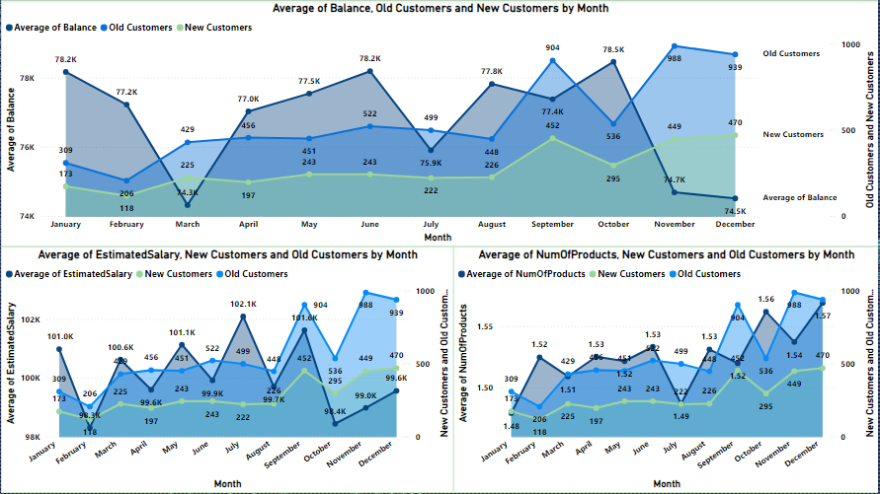
Customer Behavior Analysis

Slide 18
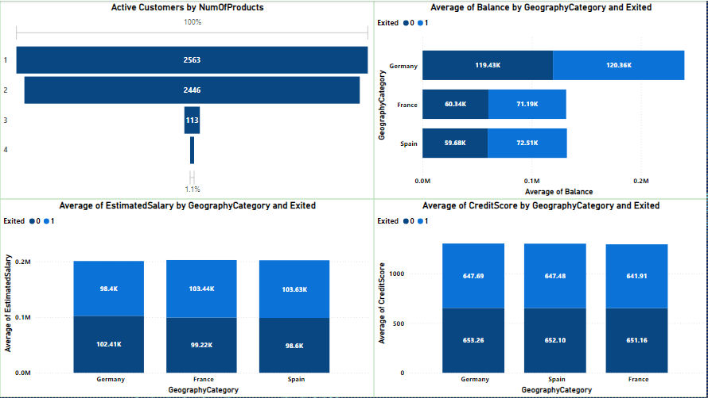
Product Affinity Study & Geography market trends

Slide 19
Conclusion
The bank has experienced a consistent churn rate over the years, despite a steady increase in customer acquisition.
Customers with lower credit scores and those using fewer products are more likely to churn.
Age groups Old and Middle have the highest churn rates, indicating specific retention challenges.
Improving customer engagement, enhancing customer service, and offering competitive products/services are key strategies to reduce churn.
Targeted marketing and personalized offers can help retain customers in critical age and credit score groups.
Overall, by focusing on customer engagement, service enhancement, and targeted strategies for specific customer segments, the bank can reduce churn, improve customer retention, and foster long-term customer loyalty.

Slide 20
THANK YOU

